Slide 1
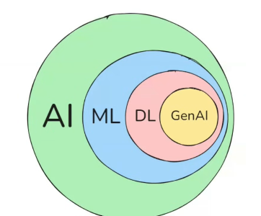

π
Clone
July 2025
π

Slide 2
π
Index
j
k
k
d
c
b
g
Notes:
Content: https://www.linkedin.com/pulse/chunking-strategies-ai-data-kash-kashyap-0lghe/

Slide 3
π
g
Notes:
Content: https://www.linkedin.com/pulse/chunking-strategies-ai-data-kash-kashyap-0lghe/

Slide 4
π
Notes:
Content: https://www.linkedin.com/pulse/chunking-strategies-ai-data-kash-kashyap-0lghe/

Slide 5
π
Notes:
Content: https://www.linkedin.com/pulse/chunking-strategies-ai-data-kash-kashyap-0lghe/

